Slide 1


CHAPTER 3
Research Design
DISCOVER . LEARN . EMPOWER

Slide 2
INDEX
Meaning and need for research design
Features of a good design
Important concepts relating to research design: Observation and Facts
Laws and Theories
Prediction and explanation
Induction
Basic Principal of Experimental Design

Slide 3
Meaning and need for research design
The formidable problem that follows the task of defining the research problem is the preparation of the design of the research project, popularly known as the “research design”.
“A research design is the arrangement of conditions for collection and analysis of data in a manner that aims to combine relevance to the research purpose with economy in procedure.”
The designing decisions happen to be in respect of:
(i) What is the study about?
(ii) Why is the study being made?
(iii) Where will the study be carried out?
(iv) What type of data is required?

Slide 4
One may split the overall research design into the following parts:
The sampling design which deals with the method of selecting items to be observed for the given study
The observational design which relates to the conditions under which the observations are to be made;
The statistical design which concerns with the question of how many items are to be observed and how the information and data gathered are to be analysed; and
The operational design which deals with the techniques by which the procedures specified in the sampling, statistical and observational designs can be carried out.

Slide 5
In brief, research design must, at least, contain:
A clear statement of the research problem
Procedures and techniques to be used for gathering information
The population to be studied
Methods to be used in processing and analyzing data

Slide 6
NEED FOR RESEARCH DESIGN
Research design stands for advance planning of the methods to be adopted for collecting the relevant data and the techniques to be used in their analysis, keeping in view the objective of the research and the availability of staff, time and money.
Preparation of the research design should be done with great care as any error in it may upset the entire project.
Research design, in fact, has a great bearing on the reliability of the results arrived at and as such constitutes the firm foundation of the entire edifice of the research work.

Slide 7
FEATURES OF A GOOD DESIGN
A good design is often characterized by adjectives like flexible, appropriate, efficient, economical and so on.
The design which minimizes bias and maximizes the reliability of the data collected and analyzed is considered a good design.
The design which gives the smallest experimental error is supposed to be the best design in many investigations.
A research design appropriate for a particular research problem, usually involves the consideration of the following factors:
(i) The means of obtaining information
(ii) The availability and skills of the researcher and his staff, if any.
(iii) The objective of the problem to be studied
(iv) The nature of the problem to be studied
(v) The availability of time and money for the research work.

Slide 8
IMPORTANT CONCEPTS RELATING TO RESEARCH DESIGN
1. Dependent and independent variables
2. Extraneous variable
3. Control
4. Confounded relationship
5. Research hypothesis
6. Experimental and non-experimental hypothesis-testing research
7. Experimental and control groups
8. Treatments
9. Experiment
10. Experimental unit(s)

Slide 9
BASIC PRINCIPLES OF EXPERIMENTAL DESIGNS
The Principle of Replication
The Principle of Randomization
Principle of Local Control

Slide 10
Important Experimental Designs
(a) Informal experimental designs:
Before-and-after without control design.
After-only with control design.
Before-and-after with control design.
(b) Formal experimental designs:
Completely randomized design (C.R. Design).
Randomized block design (R.B. Design).
Latin square design (L.S. Design).
Factorial designs.

Slide 11
DIFFERENT RESEARCH DESIGNS
Research design in case of exploratory research studies
Research design in case of descriptive and diagnostic research studies
Research design in case of hypothesis-testing research studies.

Slide 12

Research Design | Type of study
 | Exploratory of Formulative | Descriptive/Diagnostic
Overall design | Flexible design (design must provide opportunity for considering different aspects of the problem) | Rigid design (design must make enough provision for protection against bias and must maximise reliability)
Sampling design Statistical design Observational design Operational design | Non-probability sampling design (purposive or judgement sampling) No pre-planned design for analysis Unstructured instruments for collection of data No fixed decisions about the operational procedures | Probability sampling design (random sampling) Pre-planned design for analysis Structured or well thought out instruments for collection of data Advanced decisions about operational procedures.

Slide 13

Before-and-after without control design

Slide 14

After-only with control design

Slide 15
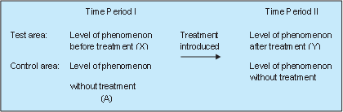
Before-and-after with control design

Slide 16
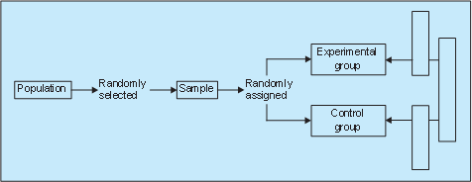
Completely randomized design (C.R. design)
(i) Two-group simple randomized design

Slide 17
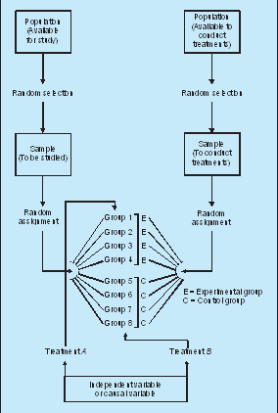
Completely randomized design (C.R. design)
(ii) Random replications design

